Slide 1

DATA SCIENCE
R.Loka vigneswar reddy
21AK5A0321

Slide 2
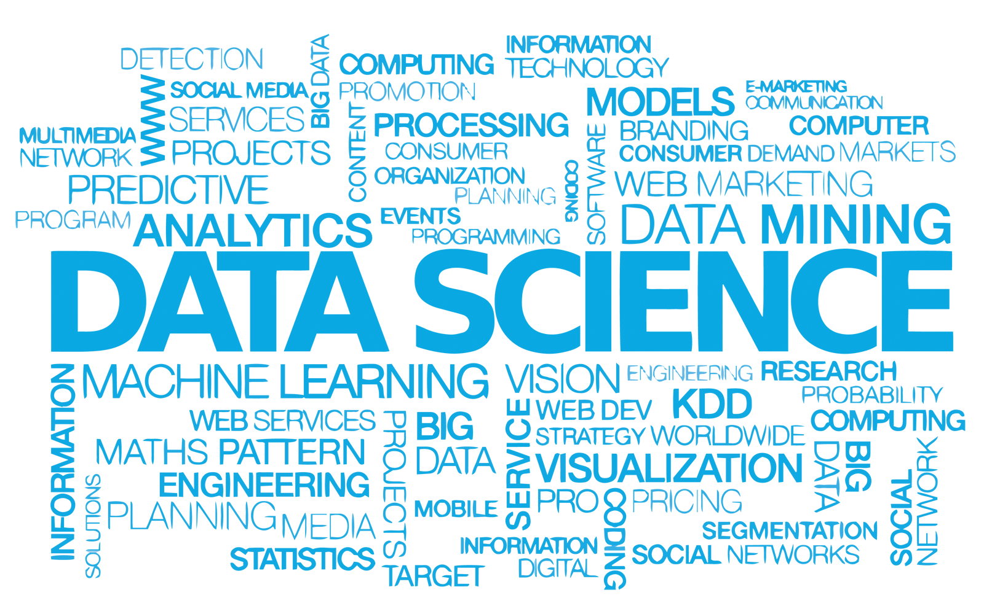
DATA SCIENCE VOCABULARY
4

Slide 3
WHAT IS DATA SCIENCE?
“Data science, also known as data-driven science, is an interdisciplinary field of scientific methods, processes, algorithms and systems to extract knowledge or insights from data in various forms, either structured or unstructured, similar to data mining.”
5

Slide 4
WHAT IS DATA SCIENCE?
“Data science, also known as data-driven science, is an interdisciplinary field of scientific methods, processes, algorithms and systems to extract knowledge or insights from data in various forms, either structured or unstructured, similar to data mining.”
“Data science intends to analyze and understand actual phenomena with ‘data’. In other words, the aim of data science is to reveal the features or the hidden structure of complicated natural, human, and social phenomena with data from a different point of view from the established or traditional theory and method.”
5

Slide 5
WHAT IS DATA SCIENCE?
Fourth paradigm
“… change of all sciences moving from observational, to theoretical, to computational and now to the 4th Paradigm – Data-Intensive Scientific Discovery”

Slide 6
WHAT IS IMPORTANT?
Need to solve a real problem using data… No applications, no data science.

Slide 7

DATA SCIENCE AS A UNIFIER
Humanities
Machine/
Data Management
Statistical Learning
Data Science
Application Domain Expertise
Law
Social Science
Visualization
Mathematical Optimization

Slide 8
DATA SCIENCE AND BIG DATA
They are not the “same thing”
Big data = crude oil
Big data is about extracting “crude oil”, transporting it in “mega tankers”, siphoning it through “pipelines”, and storing it in “massive silos”
Data science is about refining the “crude oil”

Slide 9


DATA SCIENCE AND ARTIFICIAL INTELLIGENCE
Data Science
Artificial Intelligence
ML/DM/ Analytics

Slide 10
DATA SCIENCE AND ARTIFICIAL INTELLIGENCE
Data Science
Artificial Intelligence
ML/DM/ Analytics
“Data science produces insights.
Machine learning produces predictions”
10

Slide 11
DATA SCIENCE APPLICATION EXAMPLES
Fraud detection
Investigate fraud patterns in past data
Early detection is important
Before damage propagates
Harder than late detection
Precision is important
False positive and false negative are both bad
Real-time analytics
11

Slide 12
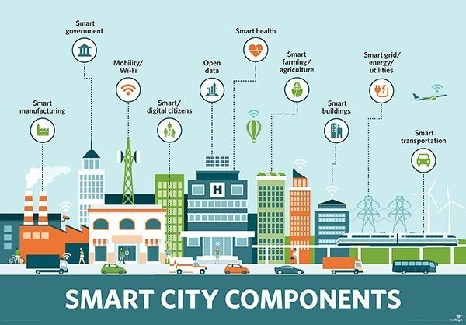
DATA SCIENCE APPLICATION EXAMPLES
“Smart cities”
Not well-defined
14

Slide 13


HOLISTIC APPROACH TO DATA SCIENCE
Core
Data Security & Privacy
Data
Making Data Trustable & Usable
Data
Management of Big Data
Modeling & Analysis
Dissemination & Visualization
Acquisition
Preservation
Ethics, Policy & Social Impact
Application
Application
Application
Application
16

Slide 14
CORE RESEARCH ISSUES & INTERACTIONS
Making Data Trustable & Usable
Big Data Management
Modelling & Analysis
Data
Visualization & Dissemination
17

Slide 15
CORE RESEARCH ISSUES & INTERACTIONS
Data cleaning
Sampling
Data provenance
Making Data Trustable & Usable
Big Data Management
Modelling & Analysis
Data
Visualization & Dissemination
17

Slide 16
CORE RESEARCH ISSUES & INTERACTIONS
Data cleaning
Sampling
Data provenance
Making Data Trustable & Usable
Data lakes
Batch & online access
Platforms
Big Data Management
Modelling & Analysis
Data
Visualization & Dissemination
17

Slide 17
CORE RESEARCH ISSUES & INTERACTIONS
Data cleaning
Sampling
Data provenance
Making Data Trustable & Usable
Data lakes
Batch & online access
Platforms
Big Data Management
Modelling & Analysis
Models & methods for data lakes
Unsupervised classification & AI
Data
Visualization &
Dissemination
17

Slide 18
CORE RESEARCH ISSUES & INTERACTIONS
Data cleaning
Sampling
Data provenance
Making Data Trustable & Usable
Data lakes
Batch & online access
Platforms
Big Data Management
Modelling & Analysis
Visualization for wider audience
Visualization for data exploration
Models & methods for data lakes
Unsupervised classification & AI
Data
•
Open data technologies
Visualization &
Dissemination
17

Slide 19
THAK YOU FOR GIVING THIS OPPORTUNITY I WILL IMPROVE MY KNOWLADGE BY THIS PROJECT

